Slide 1
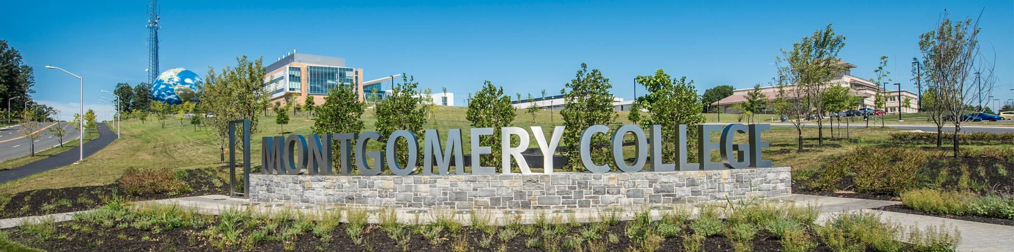
Team 26 - Data Challenge
Transportation Management
By: Melanie Veliz, Michael Prebble, Franklin Dasho, and Adeel Ahmad
Montgomery College
Engineering Majors
1

Slide 2

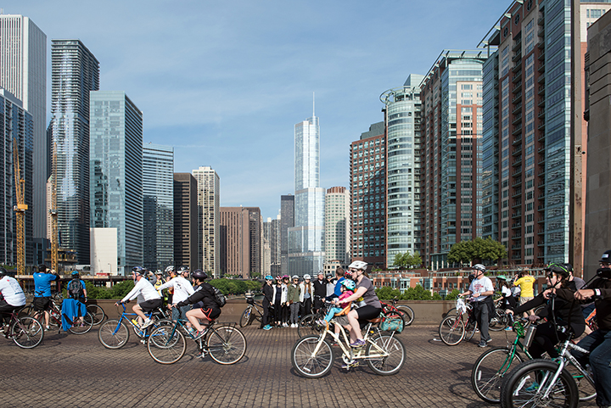
Dataset Level 1:
Transportation Management
What is the best alternative way to travel, and is it optimum?
Drive alone, ride with others, walk, bicycle, telework, etc...
2

Slide 3
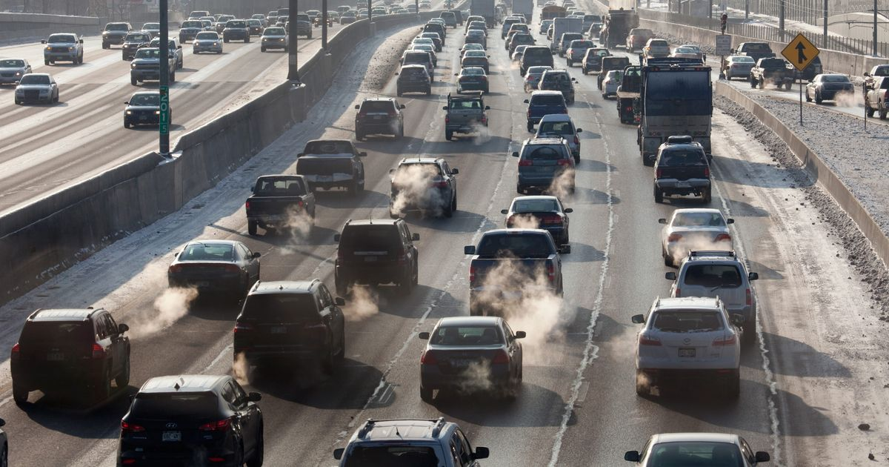
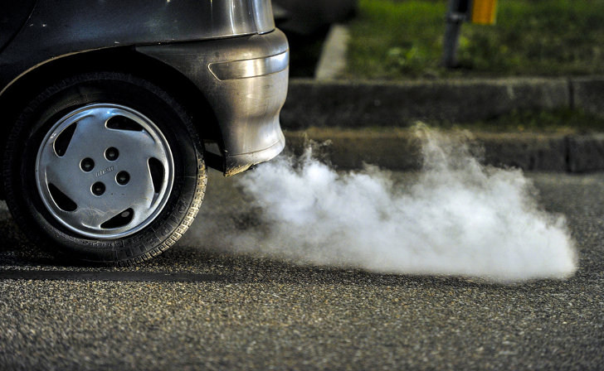
The Problem
Pollution, traffic congestion, and environmental issues
TDM (Transportation Demand Management)
Survey
Image cited: https://pyxis.nymag.com/v1/imgs/387/d86/d8530afe2737272eef1a8c0f74915feb79-30-car-emissions-pollution-epa.rsocial.w1200.jpg
Image cited: https://inhabitat.com/wp-content/blogs.dir/1/files/2015/04/cars-cause-air-pollution.jpg
3
Notes:
https://www.incimages.com/uploaded_files/image/1920x1080/getty_153134181_93228.jpg

Slide 4
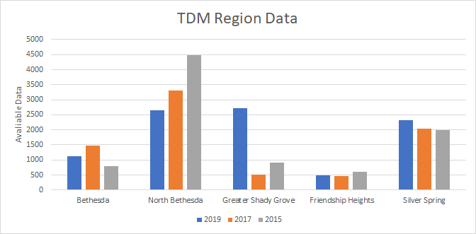
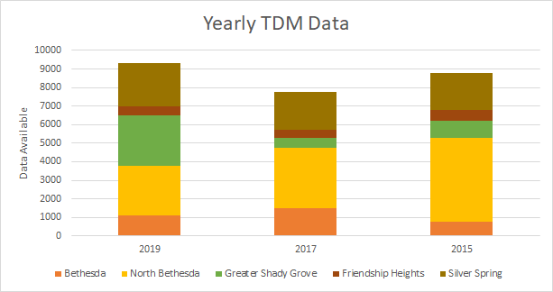
Data Used:
Year 2017
Most recent
Most amount of data (without being overwhelming)
Data within 2017
Form of transportation
# of miles traveled
4

Slide 5

Total Actual VMT generated by employees commuting by automobile
What is VMT?
How to calculate total VMT?
What does column q3a, q6mon, q6tue, q6wed, q6wed, q6thu, q6fri, q6sat, q6su, agency and service represent?
5
Notes:
Image cited from https://www.google.com/url?sa=i&url=https%3A%2F%2Fwww.youtube.com%2Fwatch%3Fv%3DQHpjlORVbsM&psig=AOvVaw3surSqBqJdjPrnNNK_kehg&ust=1614524096878000&source=images&cd=vfe&ved=0CAIQjRxqFwoTCMiTm5Gpiu8CFQAAAAAdAAAAABAP

Slide 6
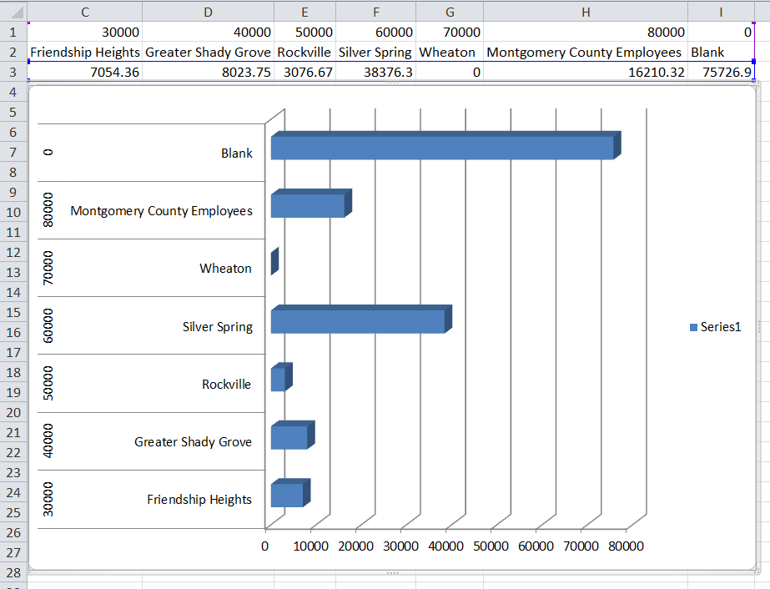
Potential VMT in 2017
Calculated potential VMT
= 190932.715 miles
Graph observations
There seemed to be no
recorded data for Wheaton
And a large amount of data
that didn’t fall into the different
services
Miles traveled

Slide 7
Results
Question 1:
Summing specific rows in q3a to find VMT
Total VMT for Bethesda = 22070.65 miles / day
Total VMT for North Bethesda = 53656.25 miles / day
Total VMT for Friendship Heights = 7054.36 miles / day
Total VMT for Greater Shady Grove = 8023.75 miles / day
Total VMT for Silver Spring = 38376.30 miles / day
Question 2:
Total Potential VMT = 190932.715 miles/day
The Actual VMT vs. Potential VMT
Potential VMT - Actual VMT = 61745.41 miles/day
7

Slide 8
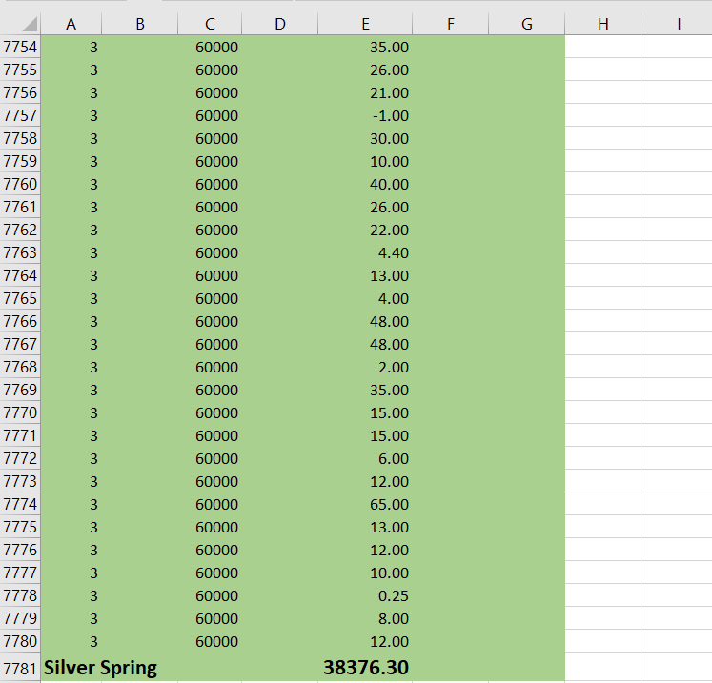

Slide 9
Advantages and Solution of Reducing VMT
Advantages:
Reduced greenhouse gas emissions and lesser air pollution
Reduced dependence on foreign oil and natural resources in general
Improves public health since people will be walking or riding bike to work
Solutions:
Shared Mobility Programs
Public Transportation
Pricing Mechanism
8
Notes:
References:
https://www.mjbradley.com/toolkit-policy-vmt-reduction-programs

Slide 10

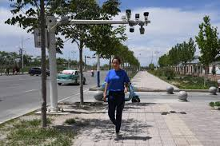
How to Improve Data?
GPS
Cameras
10

